Slide 1
Si (epi) + Indium + Si det.
Indium (20 um)
Different g-ray
Energies used:
141, 662 and
1132 keV
Source at ~3cm
Si layer
(epi)
120um
Si
det.
100 um
Different Si det.
thicknesses
Investigated:
100, 300,750 μm
and 1mm

Slide 2
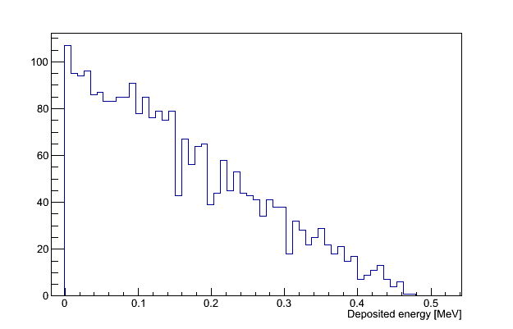
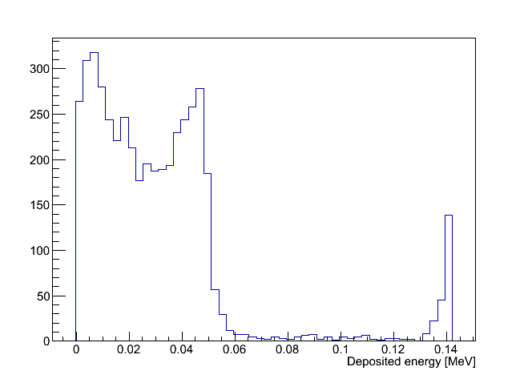
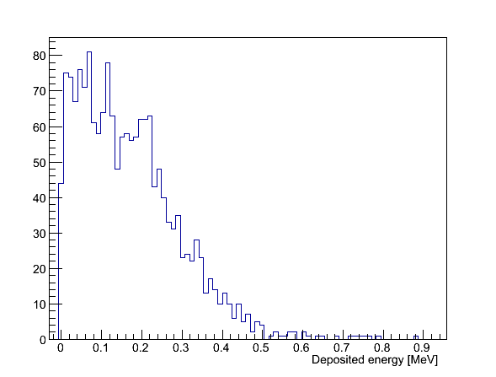
Electron Deposited Energy spectra
=1st electron from 1st g-ray interaction in Si det. ( i.e: Track id=2 or Track Parent id =2)
Thus, no Mult. Scattering shown here !
- obtained with 750 μm Si detectors
662 keV
(Compton edge at 477 kev)
141 keV
Compton edge
1332 keV
(Compton edge at 1117 keV)
Deposited energy
by Compton electrons
Only these events are
interesting for us
Deposited energy by
photo electrons
(some escape the Si det.)
Notes:
These are the Compton electron deposited energy distributions in the Silicon detector I used to estimate the number of first Compton interaction .
as we are only interested in Compton interaction , so I integrate the distribution up to the Compton edge to get the number of Compton events
At High energy, I integrate all
At 141, there are some event where photo absorption occur and this what we see above the Compton edge.
Not that this is not multiple scattering event because of the condition I apply means that I only look at the 1st electron of the 1 interaction. (Track id=2 or Track parent Id==2)
So I produce those distributions with and without applying a veto condition regarding any interaction in the back layers, so I end up with 2 numbers for which I calculate the ratio.
And the results are shown in the next slide.
Note : Some of the events in these Compton distribution will undergo a second Compton interaction or more, or a photoabsorption in the Silicon detector.
At 141 keV, this is estimated to at the least: 6 to 7%

Slide 3
Preliminary results considering 120um Si (epi) layer
%=
Compton with veto
Compton without veto
Veto= 2nd Compton
or photo absorption in
Indium or Si back layers
For 141keV, ~3% of Compton events in Si detector have also an interaction in back layers,
Independently of the Si detector thickness
Above 600 keV, this drops to ~1%
Could be also even better with 50 μm Si instead of 120 mm. (Not done)
Notes:
So the veto is defined by a Compton or photo absorption in any of the back layer.
First, one can say that it’s almost independent of the Silicon detector thickness
And then the worse case scenario is at 141 keV as one can expect but loss is only ~3 % and it is almost independent of the Si detector thickness
At higher energy lost drops to 1%.

Slide 4
Note: the primary Compton electron could also hit the In and Si back layer
Si asic
Veto
includes:
Indium
…
Si det.
e⁻
γ
But Not:
Here, not all the
electron energy is deposited
in the Si detector !!!
We could have multiple
scattering with total deposited energy below Compton edge.
Can be significant according
to GEANT4 !?
Still need to be quantified but
should not be very significant
Notes:
The next slide is just specify a bit more how I use the back layer as veto
Veto is applied any interaction of a scattered photon independently of what happens in the Si detector.
Multiple scattering is also not remove from the

Slide 5
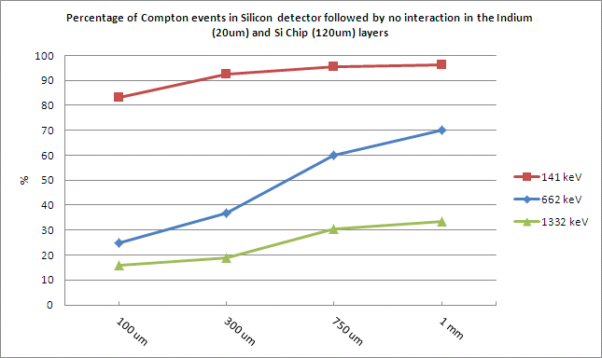
When included in the veto
⇒Significant drop for high energy g-ray and thin Si detector
At high energy, the thicker the detector, the better
At low energy, risk of multiple scattering with thick detector
(to be checked)
Notes:
This what happen if you add this type of events to the veto.
It is quite different to the previous when but it is just reflects the efficiency to stop the Compton electron and measure its full energy.
Now , I have not investigate this further.

Slide 6
Some first thoughts
Events where first Compton e- leaves the Si and hit the back layers are significant for high energy γ-rays according to the simulations.
would happen independently of the presence or not of the back layers.
It is not a pixel detector effect !!
Could be minimized with thicker Si detector.
And possibly with applied E field (not considered here)
At least for high energy g-ray, a double-layer of thin Silicon detector
to measure scattered e- position could be advantageous

Slide 7
Adding the absorber
Germanium Absorber (2 cm thick), placed ~1cm behind of the Si detector

Slide 8
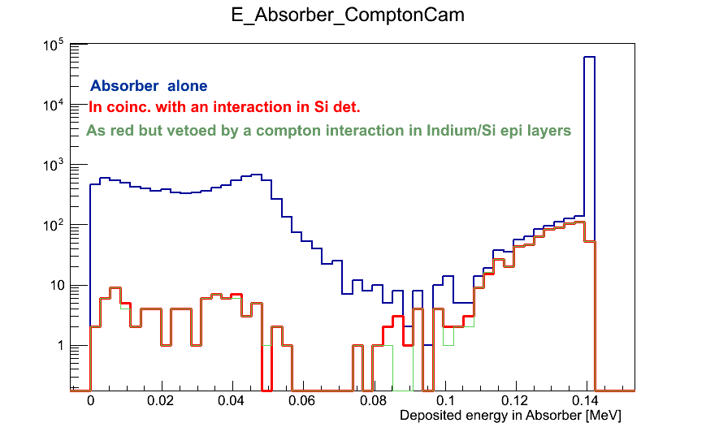
Deposited energy spectra in Absorber
For 141 keV
Only ~ 1% of the events with an interaction in Si det and in Ge Absorber present also an
interaction in the Indium and Si epi layers.

Slide 9
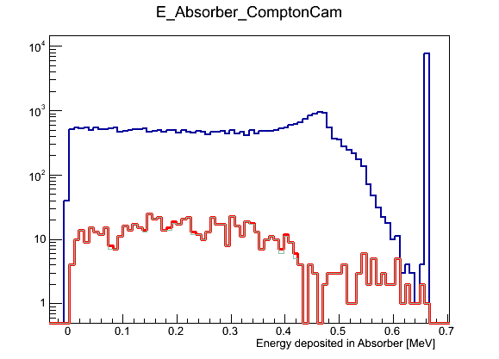
Deposited energy spectra in Absorber
For 662 keV
Only ~ 1% of the events with an interaction in Si det and in Ge Absorber present also an
interaction in the Indium and Si epi layers.

